Slide 1
Electrical
and Electronics science
First year
Computer Science and Engineering
Dr. Shakti Singh
ASSISTANT PROFESSOR
ELECTRCIAL AND INSTRUMENATION
ENGINEERING DEPARTMENT
@shakti.singh@thapar.edu

Slide 2
Configuration of BJT
When designing or looking at a transistor circuit there are three different circuit configurations that can be used.
The three different transistor circuit configurations are: common emitter, common base and common collector (emitter follower)
Each configuration has different properties in terms of the gain, and input and output impedance, etc. and as a result, a particular configuration will be selected during the electronic circuit design process.

Slide 3
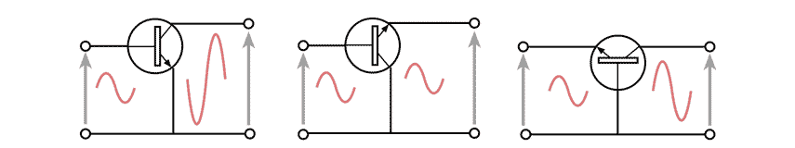
Configuration of BJT
In addition to selecting the right circuit configuration or topology in the electronic circuit design stage, to provide the required basic performance, additional electronic components are placed around the transistor: typically resistors and capacitors, and the values are calculated to give the exact performance needed.

Slide 4
Common Base
This transistor configuration provides a low input impedance while offering a high output impedance. Although the voltage is high, the current gain is low and the overall power gain is also low when compared to the other transistor configurations available. The other salient feature of this configuration is that the input and output are in phase.
This transistor configuration is probably the least used, but it does provide advantages that the base which is common to input and output is grounded and this has advantages in reducing unwanted feedback between output and input for various RF circuit design applications.
Another application is within VHF and UHF RF amplifiers where the low input impedance allows accurate matching to the feeder impedance which is typically 50Ω or 75Ω. The configuration also improves stability which is a key issue.
It is worth noting that the current gain of a common-base amplifier is always less than unity.
However the voltage gain is more, but it is a function of input and output resistances (and also the internal resistance of the emitter-base junction). As a result, the voltage gain of a common-base amplifier can be very high.

Slide 5
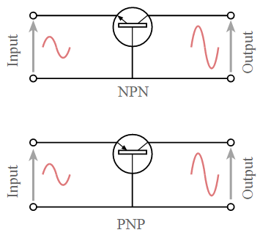
Common Base

Slide 6
Common Collector
This transistor configuration is also known as the emitter follower because the emitter voltage follows that of the base. The common collector, emitter follower offers a high input impedance and a low output impedance. The voltage gain is unity, although current gain is high. The input and output signals are in phase.
In view of these characteristics, the emitter follower configuration is widely used as a buffer circuit providing a high input impedance to prevent loading of the previous stage, and a low output impedance to drive following stages.

Slide 7
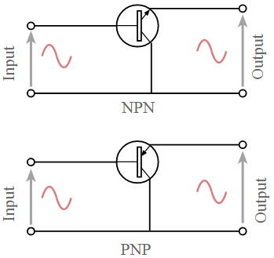
Common Collector

Slide 8
Common Emitter
This transistor configuration is probably the most widely used. The circuit provides a medium input and output impedance levels. Both current and voltage gain can be described as medium, but the output is the inverse of the input, i.e. 180° phase change. This provides a good overall performance and as such it is often the most widely used configuration.
There are several variations on the common emitter amplifier and these can easily be accommodated in the design. The most basic form of common emitter amplifier design is the simple logic buffer / output, consisting of a transistor and a couple of resistors. This can have a few extra components added to enable it to become an AC coupled amplifier with DC biasing and emitter bypass resistor.

Slide 9
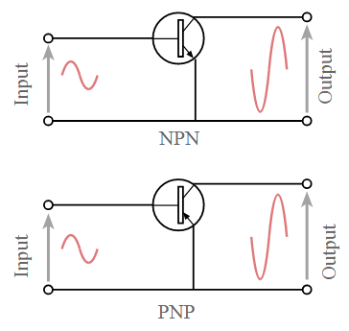
Common Emitter

Slide 10
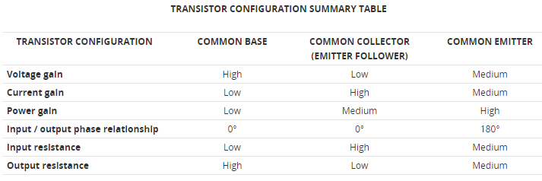
Comparison of CB, CC and CE

